Slide 1
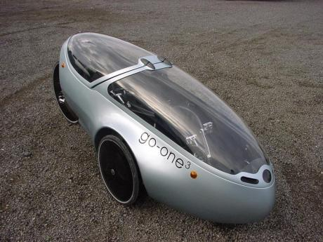
Team Velo
John Schmidt
Shawn McGinnis
Daniel Johnson

Slide 2
Power Assist & Telemetry Tracking
Power Assist
Manage power assist
Provide interface
Telemetry Tracking
Store telemetry data
Display stored telemetry data

Slide 3
Timeline
Time estimates
Actual Timeline
Considerations for the future
Time estimates will be optimistic
Planned timelines should be doubled

Slide 4
Business Case
Pricing
Performance
Sponsors:
Hugh Currin
James Long
Target Users
Hugh Currin
Cyclist-Enthusiasts

Slide 5
Requirements
Finding Actors
Who will use the system?
How will they use the system?
Requirement Diagram

Slide 6
Use Cases
Derived From
Functional requirements
Actor usage stories
Use Case Diagrams

Slide 7
System Architecture
Logical Architecture
Deployment Architecture
Physical Architecture

Slide 8
Class Models
Display Class Models

Slide 9
Code Demo
Demonstrate Code
Implementation Challenges
Learning ASP.NET/C# and interface to XML/SWF graphs.
Gauging performance of Arduino and implementing efficient code.
Favorites
Web XML parser
Current Limiting

Slide 10
System Demonstration
Web Server Demonstration
Demonstrate installation
Demonstrate live-feed
Embedded Controller
Demonstrate controller functionality

Slide 11
Questions?
Suggestions:
What is your name?
What is your favorite color?
What is the airspeed velocity of an unladen swallow?

